Slide 1
(No-, low-) code
A marketing perspective
June 26, 2019
Olivier Giraud
www.linkedin.com/in/oliviergiraudnl
 olivier.giraud@valid.nl
Notes:
Good evening. My name is Olivier Giraud. I am a marketer. And a Frenchman. And today I’m going to explain why I think marketers should be interested in coding. Aka software development.

Slide 2
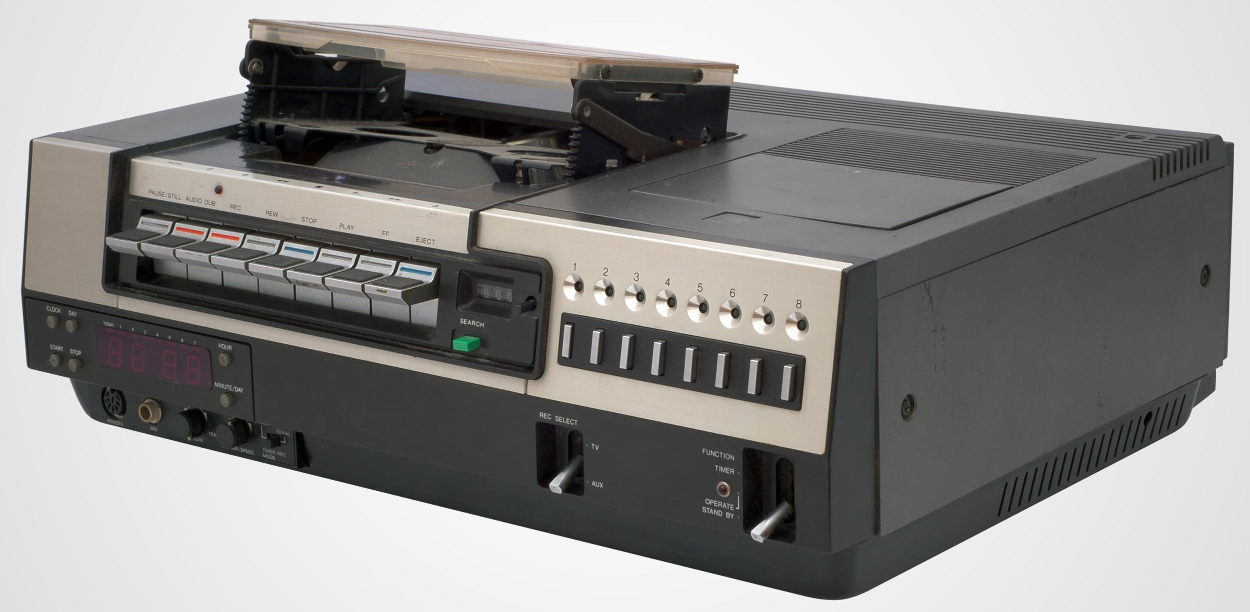
My first programming experience (1970’s)
Notes:
When I was preparing this presentation I realized that my first programming experience dated back to my early teens. We had a VCR and my mother couldn’t figure out how to program the taping of her favorite TV-shows. Just to tell the machine, tomorrow, on channel 2, tape the TV from 20:30 until 22:30, was a little complicated a task. Something I thought was fun and easy to do. So I got to program the VCR for my parents.

Slide 3
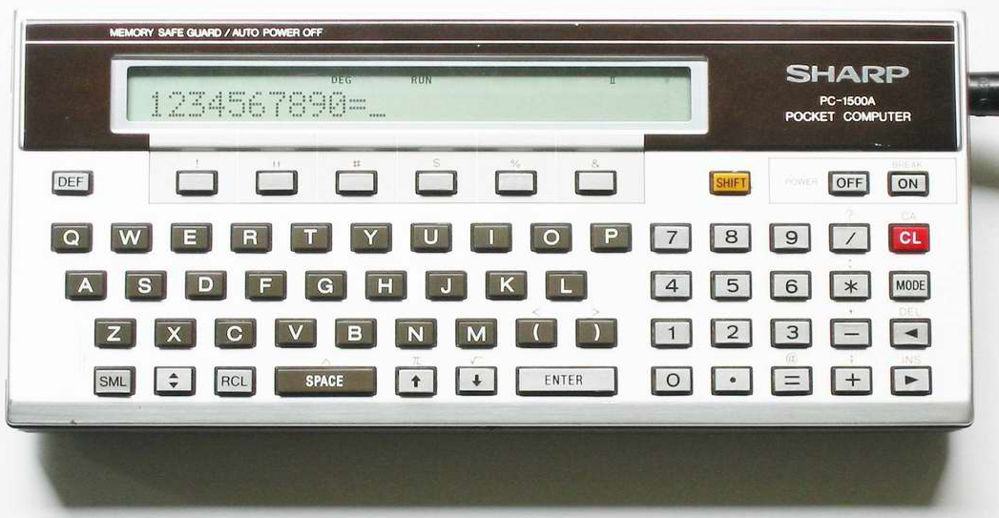
My first Pocket Computer (1980’s)
Notes:
Because of my interest for machines I convinced my dad to get met a PC, a Pocket Computer. This was my first PC and it came with BASIC, a simple programming language, and I started to better understand how such a machine works.

Slide 4
My first code
IF number < 0
THEN PRINT "Number is negative“
ELSEIF number > 0
THEN PRINT "Number is positive"
ELSE PRINT "Number is zero"
END IF
Notes:
By learning the basics of BASIC, I understood that code translates what a user sees and do into commands… For an application, for a particular machine, for communications between machines. In this presentation I will be using code and software in the same way.

Slide 5
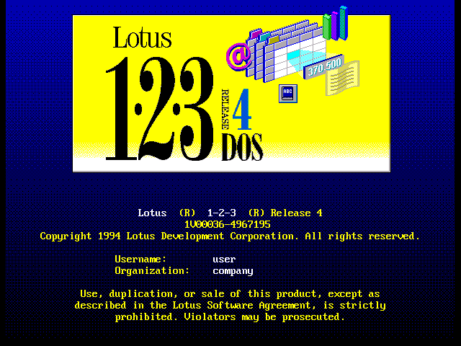
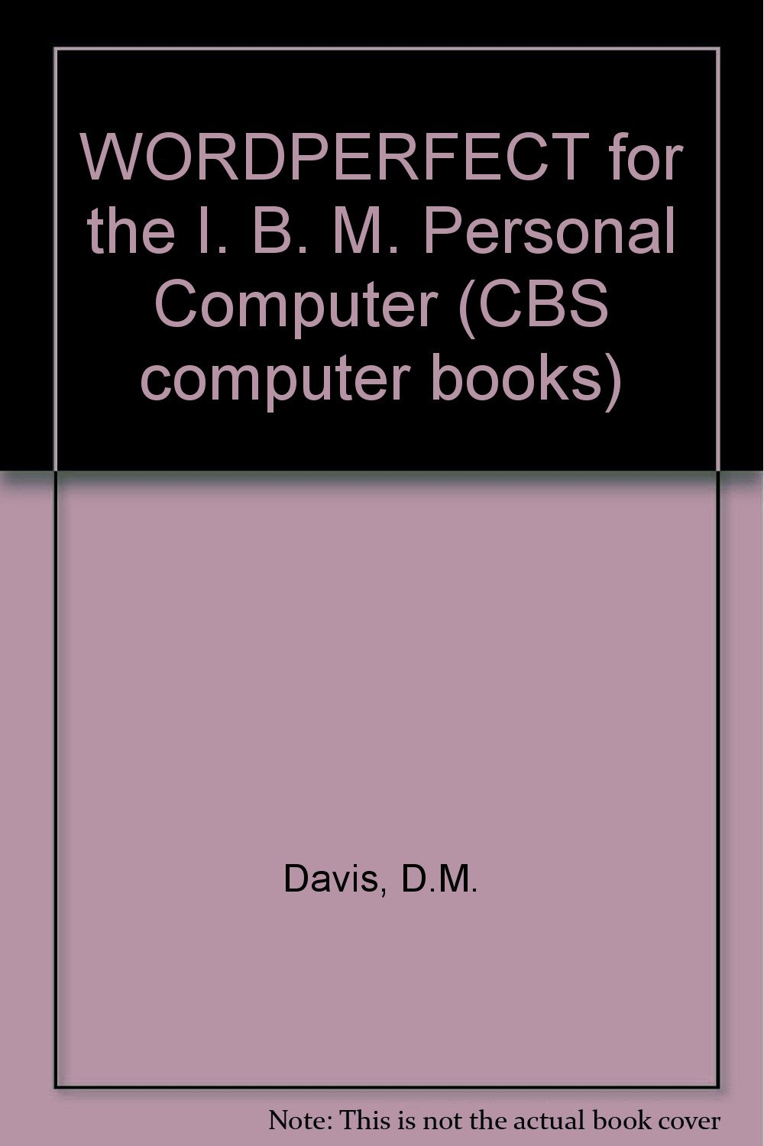
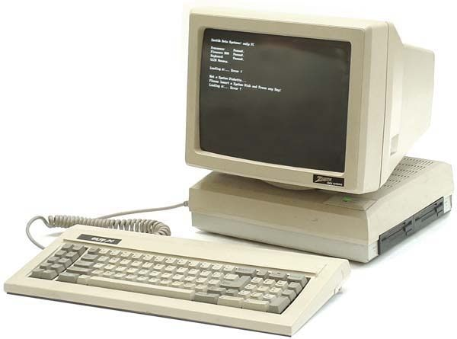
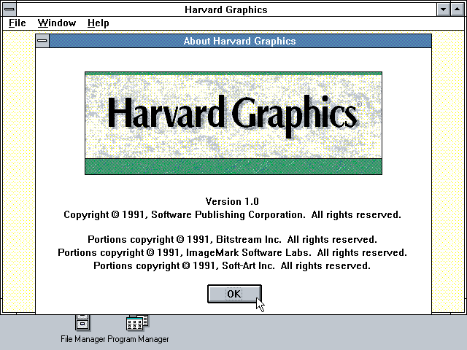
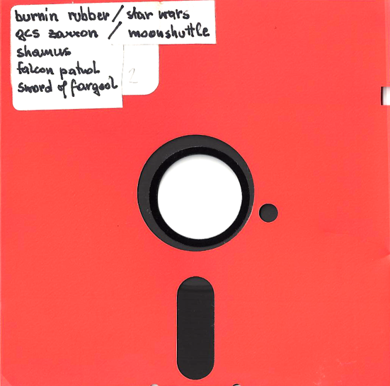
My first IBM-compatible PC (late 1980’s)
Notes:
I went to university and had to learn basic software packages that made me realize how code / software can help support and even automate business processes. And by the way you could also play games, so it was also fun.

Slide 6
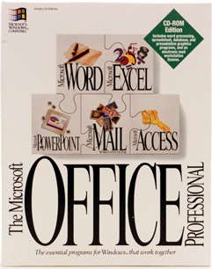
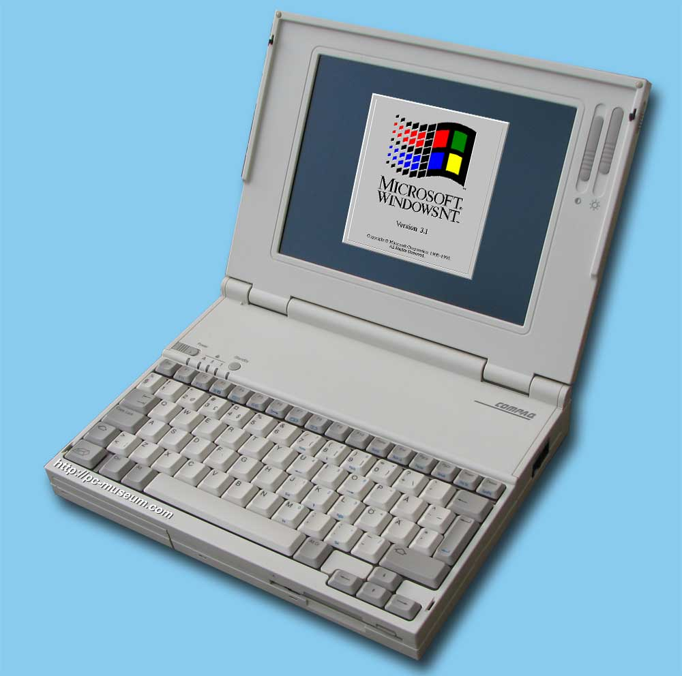
My first pure marketing job (1990’s)
Notes:
When in my first real marketing job I had to select a CRM package to support the lead generation and sales processes. Here I realized that you if you choose an off-the-shelf package, you can’t have it all. You have a long list of requirements and when you match those with available features, you must made trade-offs. Standard software is great but it isn’t the solution for everything.

Slide 7
Today: Marketing & Communication @ Valid
Microsoft-based Infrastructures, BI, Data Science, Application Development (C#)…
IT Consultants
Managed Services
Digital Business
www.valid.nl
Notes:
Fast forward many years. I am since a couple of years responsible for Marketing & Communication at an IT Service Provider, Valid. My team and I don’t only use software but we have to market software development. Among other things. My colleagues don’t develop a standard package but code custom-made solutions. To do so they specialize in C#, one of the many many languages available.

Slide 8
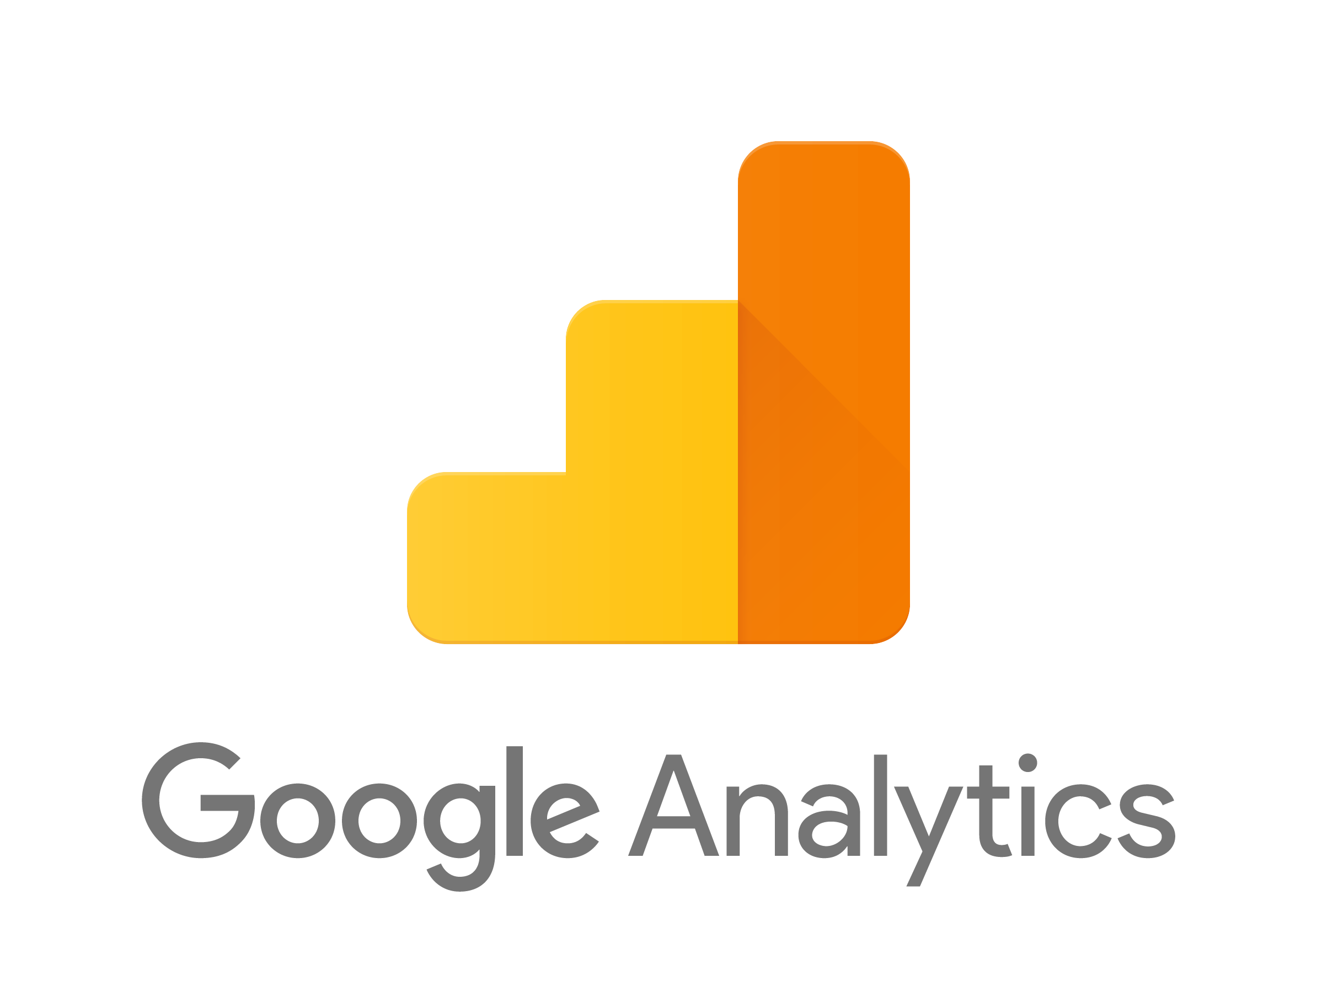
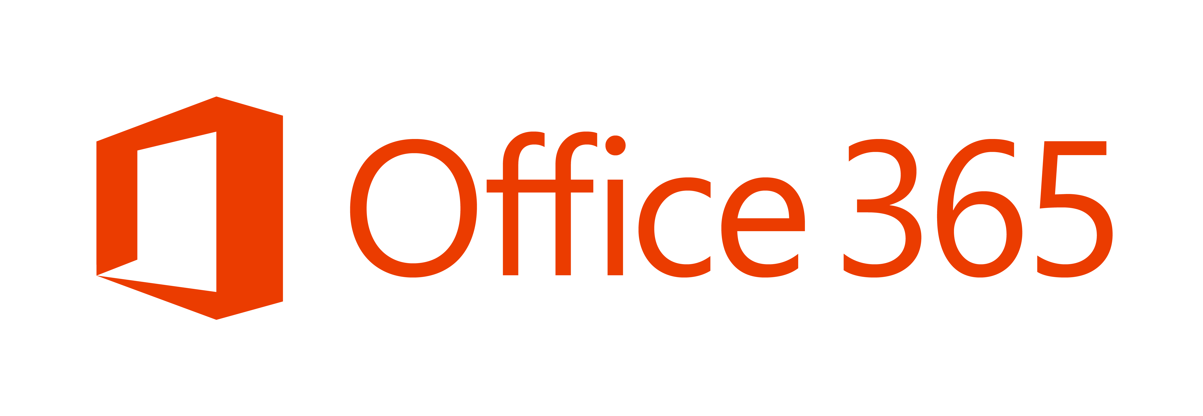
Valid’s Marketing Software (as a Service) world
Almost no IT Involved!
Notes:
If you look at the landscape of Valid’s Marketing team – with just 3 people – you see some sort of code in some shape of form in everything we do: our website is powered by a CMS and a marketing automation tool, we use Microsoft PowerBI for analytics and Adobe Creative Cloud for our graphical expresssion. Nothing out of the extraordinary here. It becomes complicated when you look at our CRM and Account-Based Marketing efforts. No less than 4 solutions: our ERP system is our Sales CRM system, and we copy-paste stuff between Hubspot, the CRM system and our account-based advertisign platforms. Everything is off the shelf, with some configuration, no coding required on our end. Except for Office 365 and the CRM system, everything else is purchased without IT involvement.

Slide 9
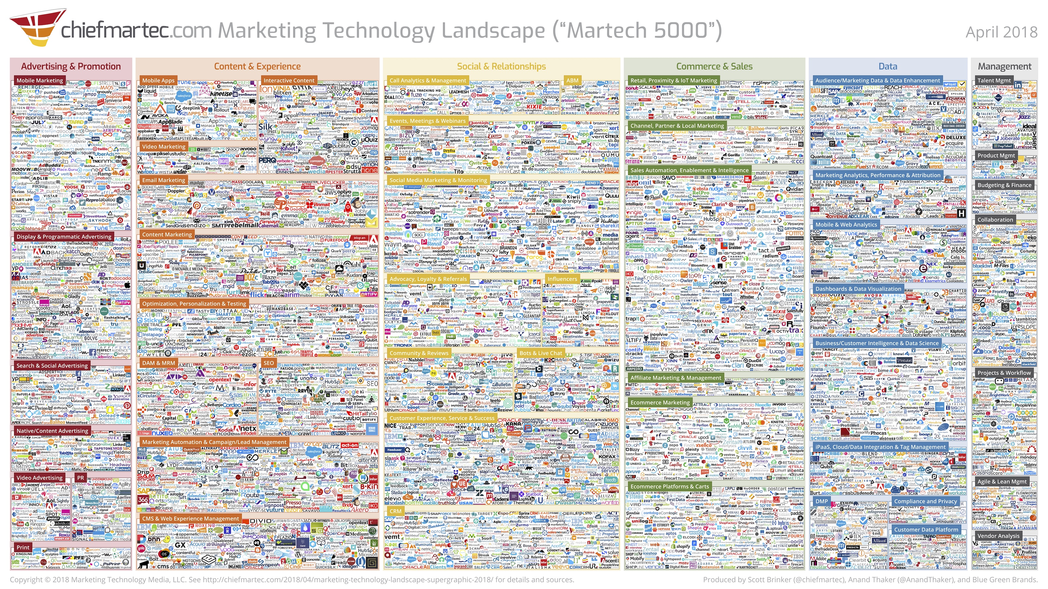
Thousands of marketing tools
Notes:
Our IT-landscape is just a reflection of what happened in Marketing Techj: we are blessed with a plethora of tools to choose from…

Slide 10
A lot has changed since the 1980’s
https://www.technologyreview.com/s/601441/moores-law-is-dead-now-what/
Notes:
In a couple of decades a few major changes have taken place. First of all we’ve seen Moore’s Law in practice: lots of computer power, becoming very cheap and available at the fingertips. Once simple and slow, machines have shrunk in size and make incredible things possible.

Slide 11
Cheap, ubiquitous computing and connectivity
THE CLOUD
Notes:
Taking advantage of Moore’s law, some very large companies are become ever larger and they offer computing and the power of code through the cloud

Slide 12
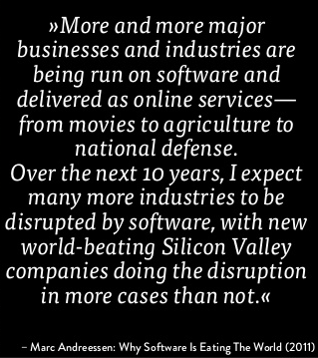
Notes:
Thanks to these developments we see, using the words of Marc Andreessen, that software is eating the world.
Or as Microsoft puts it: every company is becoming a software company.
Since Andreessen wrote this piece in 2011 we are seeing that the largest companies in the world, are technology companies.

Slide 13
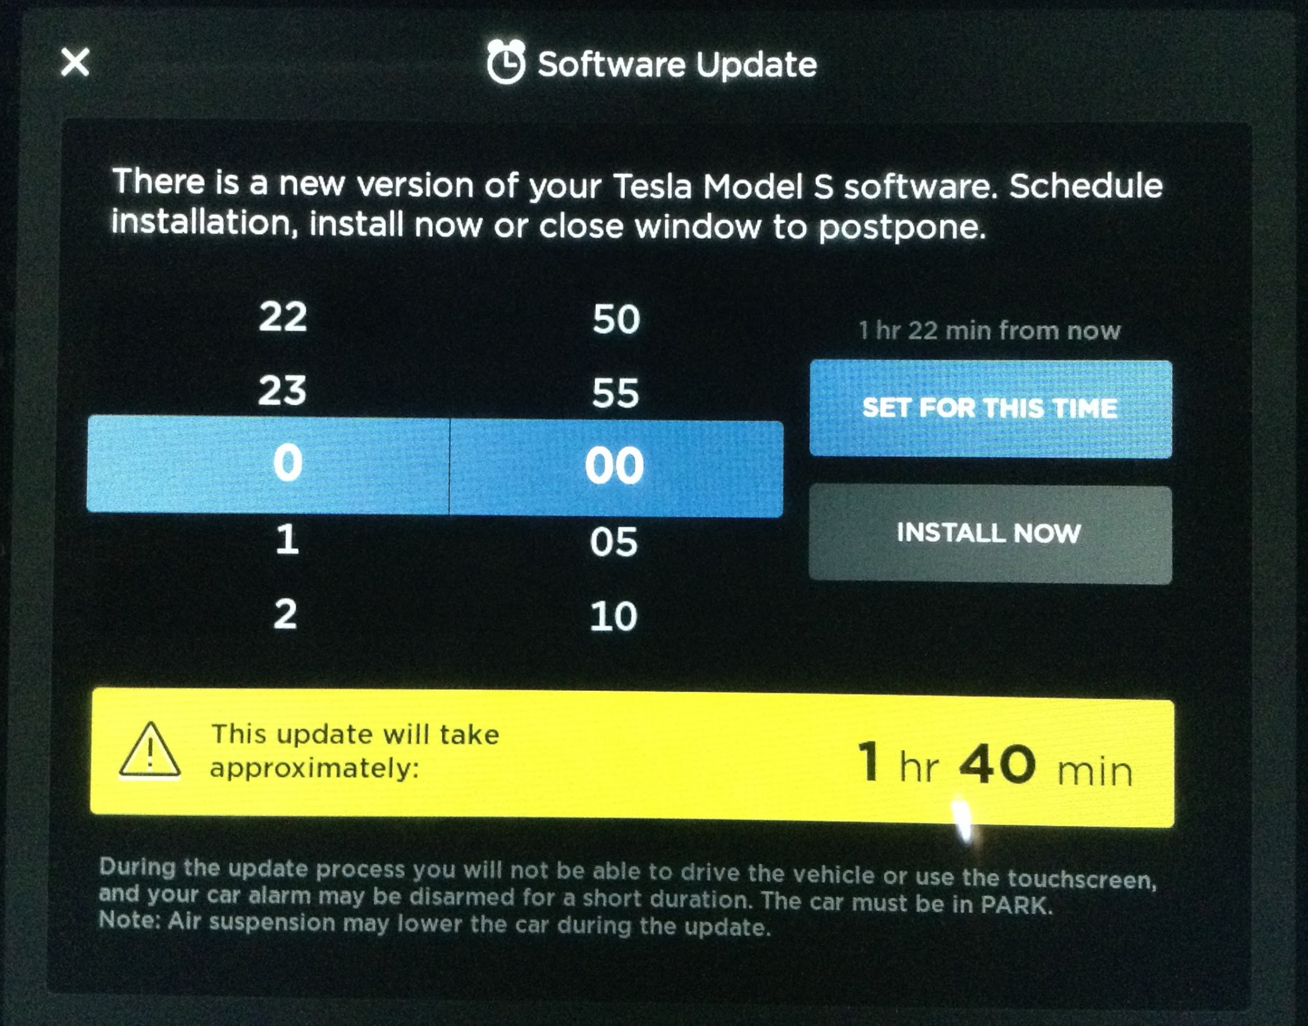
Notes:
I cannot think of a better illustration than the automobile industry. This remains an industry with very physical products. But even those products are increasingly becoming software-enabled, in the best and worst sense of the word. The competitive battle is becoming a battle on who develops the best software.

Slide 14
Software developers very much in demand
☞
https://www.matchcare.nl/wp-content/uploads/2019/06/Arbeidsmarktrapportage2019Q1.pdf
Notes:
As a result of these developments it is no surprise to discover that software developers are very much in demand. In fact they are among the most sought-after employees in the Netherlands.
By the way, if you are looking for a job, you’d better become either a software developer or go into Sales…

Slide 15
A perfect storm in the making
Developers = scarce resource
Make or buy?
Is there a choice?
Software everywhere, even as a service
Companies want to differentiate with code
Notes:
So the problem that’s arising is that companies increasingly want to differentiate with software. There’s a lot of software around, but that’s the same for everyone. If you want to create our own, good luck looking for software developers! In the traditional make-or-buy trade-off, there isn’t much choice. You can’t make much without resources.

Slide 16
Great opportunities for great entrepreneurs
World of opportunities
Ubiquitous computing
Digital transformation
As-a-service models
Notes:
Every challenge stimulates enterpreneurs to jump into the world of new opportunities.

Slide 17
Great opportunities for great entrepreneurs
World of opportunities
Ubiquitous computing
Digital Transformation
As-a-service models
Notes:
The other side of the perfect storm coin is the emergence of a new category of products.

Slide 18
Great opportunities for great entrepreneurs
Power Platform
Notes:
As a resultat there are about two hundred low-code/no-code products in the market available.

Slide 19
The promises of “no code”
Easy, fast development of new applications
Great UI/UX
Seamless integration
Ease of maintenance
No technology lock-in
Notes:
All these vendors promise about the same

Slide 20
So… what’s in it for my team and me?
?

Slide 21
Integrate our ‘best of breed’ applications?
?

Slide 22
Develop more point solutions?... on top of…
Mobile
campaign mgt
Event mgt
Mobile app for lead mgt

Slide 23
When I say “no code”, developer colleagues say…
.NET
C#

Slide 24
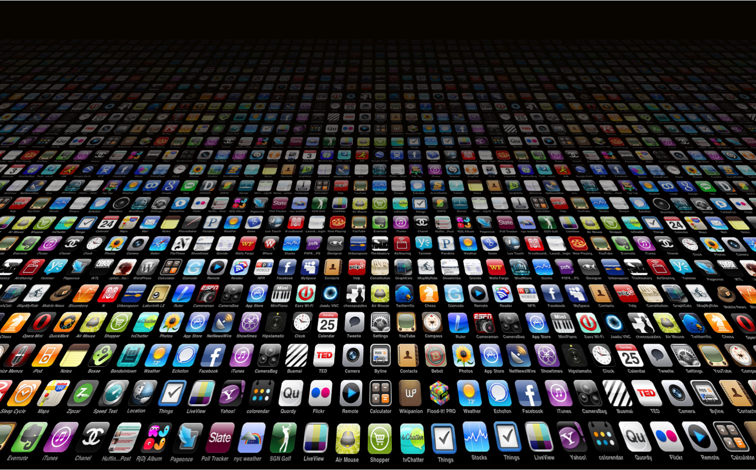
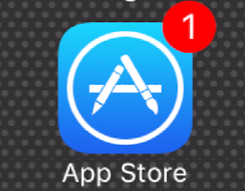
What’s next?
More than enough software tools
Plethora of low- and no-code options
Which one to use for what need?

