Slide 1
To Code or not to Code ?
Kite Thinking™
For impactful innovation
and Digital Transformation

Slide 2
Heard it before? / ”The potion that solves every problem !”
Haarlem oil (Dutch: haarlemmerolie)
It was invented in 1696 by Claes Tilly and was marketed as a cure for many ailments.
The word haarlemmerolie is now used in Dutch to indicate a fix for all problems.
Source : https://en.wikipedia.org/wiki/Haarlem_oil

Slide 3
Innovation Kite | About us
Partner to our customers for successful
Co-Innovation and Digital Transformation
Connecting Design Thinking
with Software Engineering
Kite Thinking

Slide 4
Kite Thinking / Connecting Design Thinking to Software Engineering
Design thinking is a process for
Creative problem solving.
It encourages organizations
to focus on the People they're creating for,
Leading to better products, services,
and internal processes.

Slide 5
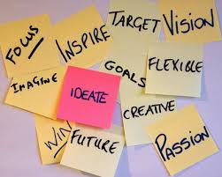
Ideation / How to add Business Value
Generating fresh ideas that can be transformed into innovative solutions.
Brainstorming with a more solution focused approach.
New business, a new product, new content, inventive ways of talking about or marketing an existing product or service.
Source :https://meetingsimagined.com
https://www.fusingcreativity.com/ideation/what-is-ideation/

Slide 6
Innovati on
=
Ideation x Execution

Slide 7
“Over the next years, the increasing scarcity in IT talent will raise the costs for software development and put the brakes on innovation”
Research “innovatiebarometer” of the Sector Organization “Nederland ICT”, May 2017

Slide 8
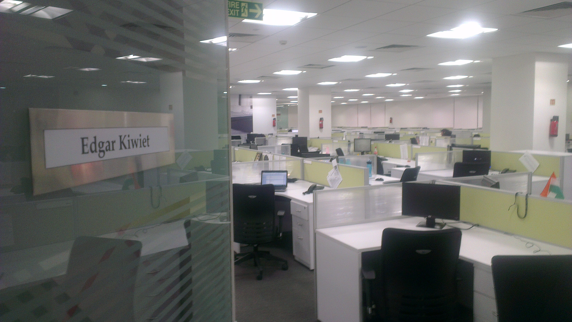
Great Ideas / Will remain just great ideas if you have no one to create them

Slide 9
What if …
You don’t need to rely on Programmers
and could
Do It Yourself ?

Slide 10
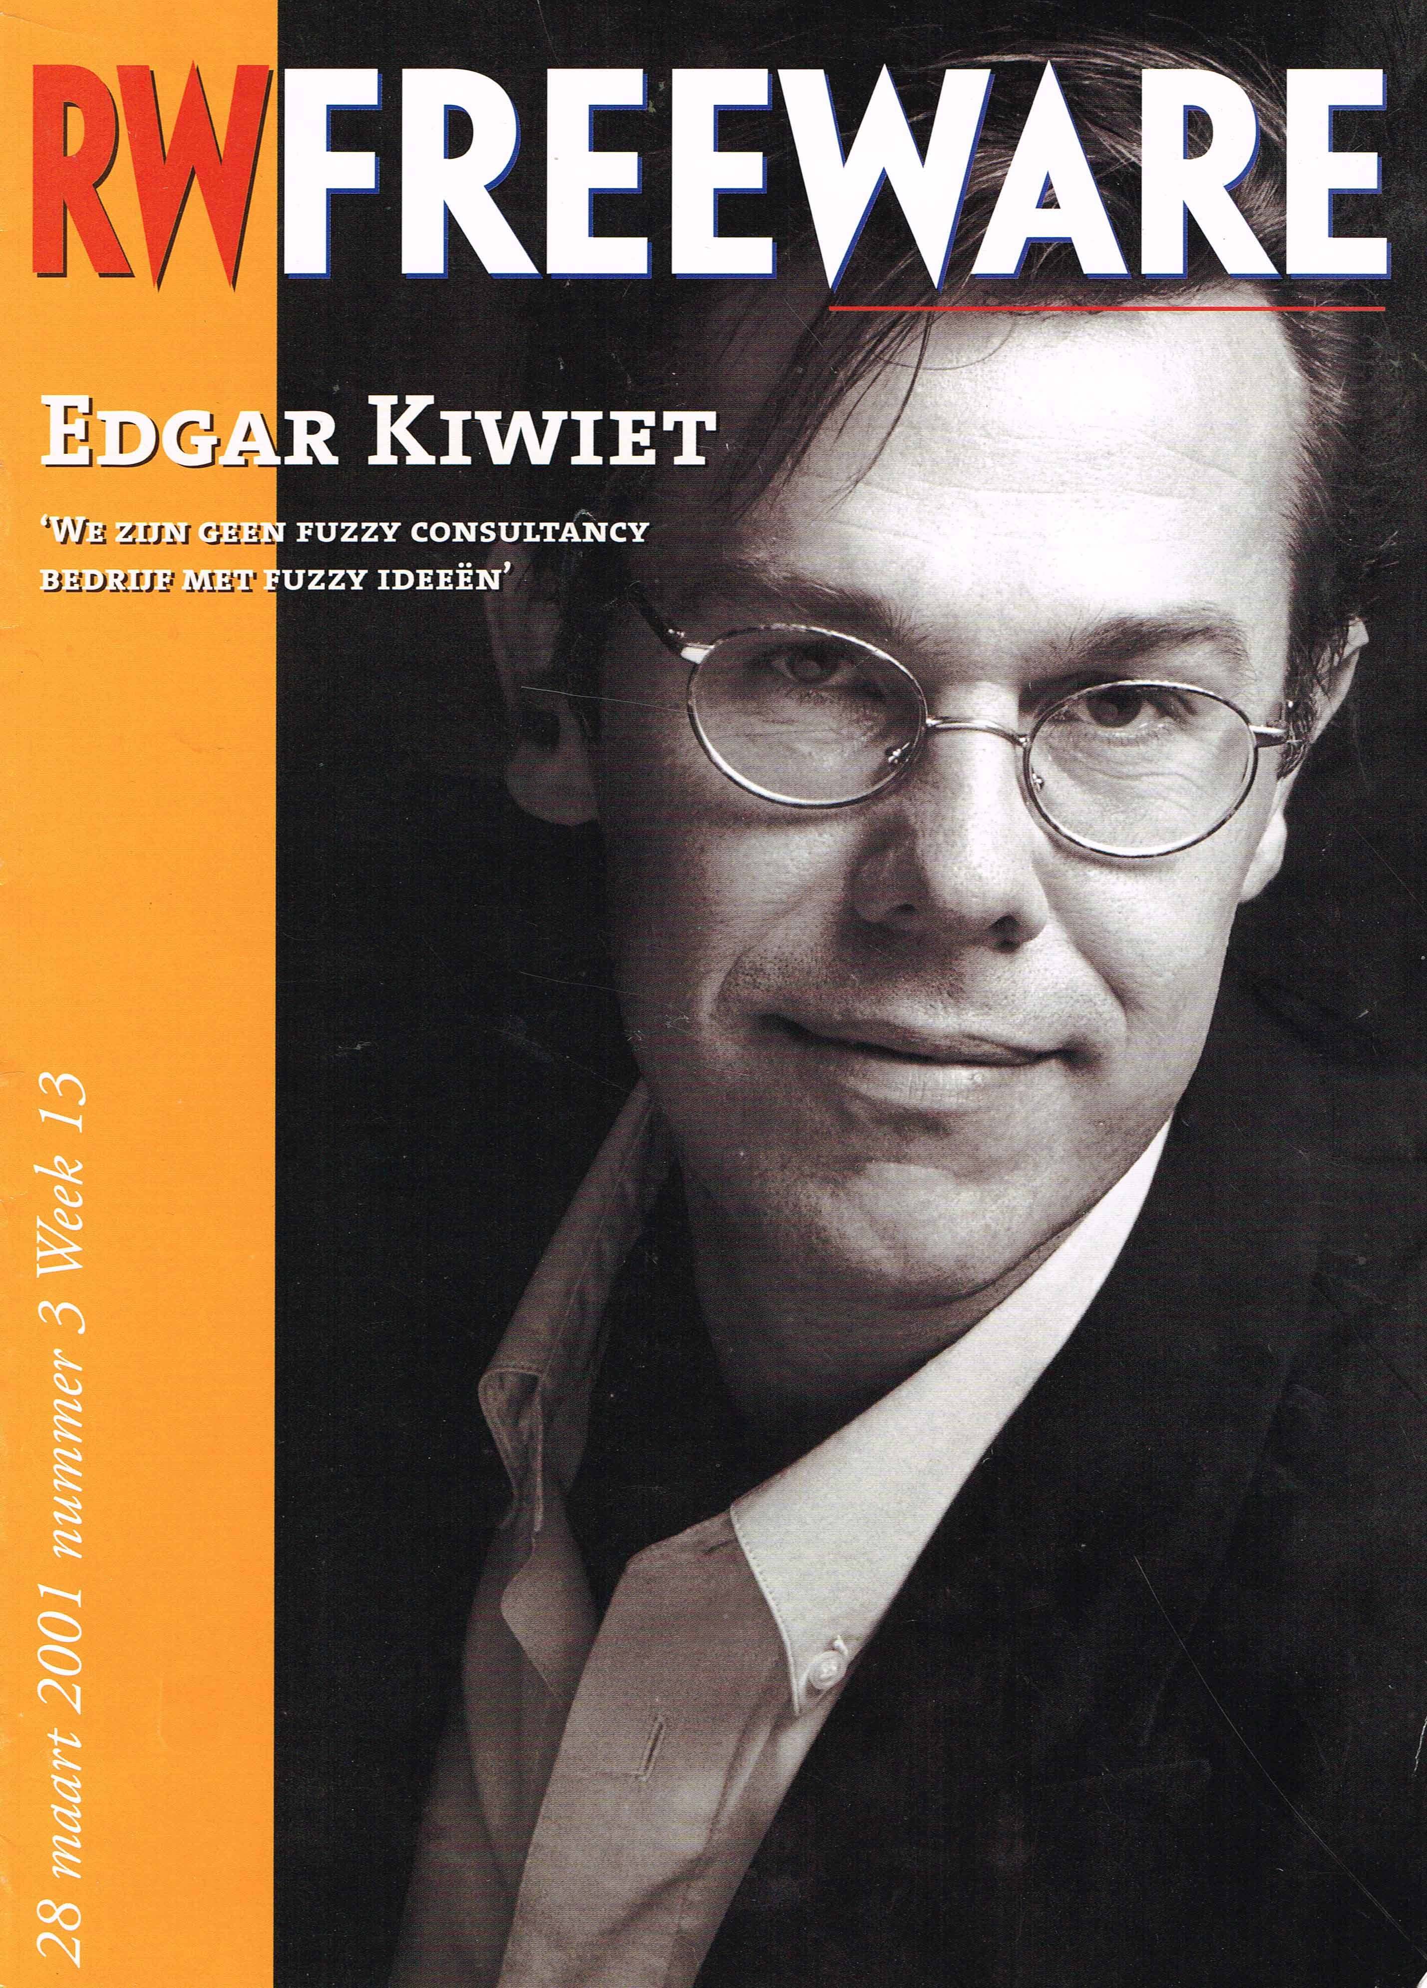
Digital Marketing in 2001 / You still had to CODE websites
id="fpAnimswapImgFP79" name="fpAnimswapImgFP79" 77"></a></font></span></td>
</span>
<td height="57" width="133" style="border: 1px solid #D5D5D5">
<span lang="en-gb">
<font size="2">
<a onmouseover="document['fpAnimswapImgFP80'].imgRolln=document['fpAnimswapImgFP80'].src;document['fpAnimswapImgFP80'].src=document['fpAnimswapImgFP80'].lowsrc;" onmouseout="document['fpAnimswapImgFP80'].src=document['fpAnimswapImgFP80'].imgRolln" title="&gt; click for details on accomplishments" href="accomplishments/accomplish%2008%20-%20pm-hrm%20-%20el%20wholesaler%20-%20eur.html">
<img border="0" src="../common/images/tile%20function%20-%20program%20mgr.gif" id="fpAnimswapImgFP80" name="fpAnimswapImgFP80" dynamicanimation="fpAnimswapImgFP80" lowsrc="../common/images/tile%20country%20-%20eur%20global%20grey.gif" width="112" height="77"></a></font></span></td>
<td height="56" width="1"></td>
</tr>
<tr>
">
.gif" width="112" height="77"></a></font></span></td>
<td height="18" width="144" style="border: 1px solid #D5D5D5">
</td>
<td height="18" width="132" style="border: 1px solid #D5D5D5">
</td>
</span>

Slide 11
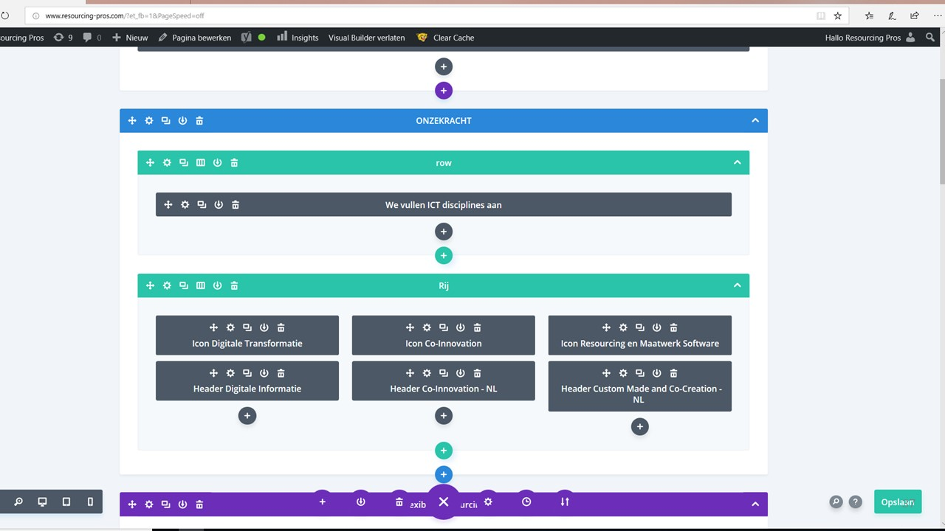
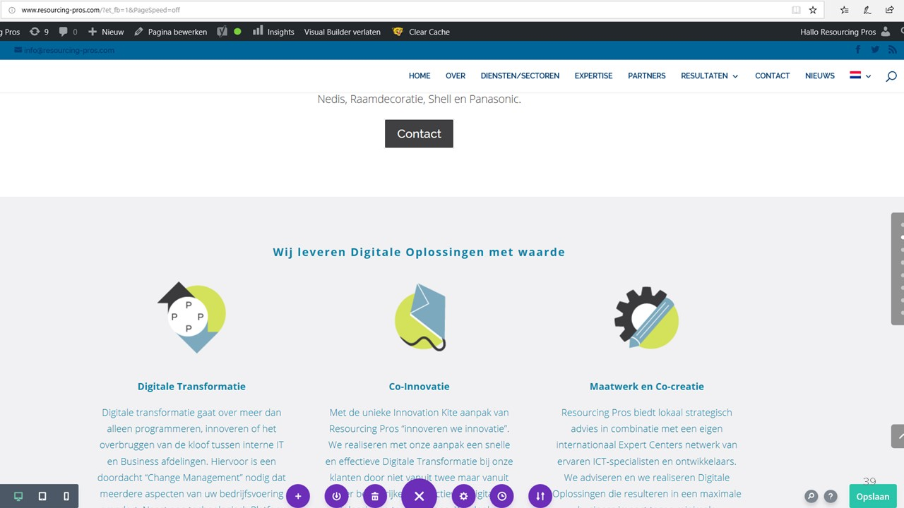
Digital Marketing in 2019 / Now you can “Do it yourself”
Drag Drop
WSIWYG

Slide 12
Wouldn’t that be great for Web based applications too ?
You need
a
programmer?

Slide 13
Enter the Low or No-Coding arena
Source : Gartner Magic Quadrant

Slide 14
Strategic Technology Partner in each Gartner quadrant
Service Now
Mendix
Betty Blocks
Source : Gartner Magic Quadrant

Slide 15
The promises of Low and No-Coding
Better Agility
Visual Engineering using pre-built modules.
Faster to build apps. Cut down time spent on app development and testing.
Reduced Cost
Developers are expensive. Talented developers even more so.
More Productivity
Building at a much faster pace. What used to take months, or even years, can now be done in a matter of hours and days.
Easily Changeable
If you need to change something in an app you’ve developed, all it takes is to create or adapt the new logic in a visual manner

Slide 16
And best of all: Do IT yourself
Hmmmmm. Didn’t I hear that before too?

Slide 17
Yes you might have
Better Agility
Easy to create new business logic on the fly
Reduced Cost
You don’t need an IT person
More Productivity
You can create it in minutes
Easily Changeable
You can change it right away

Slide 18
BUT..
Single user application
You need to copy and distribute versions
The central IT department ignores it
“This is not really a program”
Error prone
Ever heard about “spread sheet logic”?
And it is not exactly web based
You want real Apps like everyone is used too

Slide 19
And it is not that easy to create cool and usable apps
=IF($F23>0;+($M23+$O23+$Q23+$S23+$U23+$W23+$Y23+$AA23+$AC23)*AW23*$J23;0)
=IF(AND(($Q41<(EOMONTH(BM$2;0)));(EOMONTH(BM$2;0)<$R41));$U41;"")

Slide 20
In fact it is different code, not No-Code
=IF($F23>0;+($M23+$O23+$Q23+$S23+$U23+$W23+$Y23+$AA23+$AC23)*AW23*$J23;0)
=IF(AND(($Q41<(EOMONTH(BM$2;0)));(EOMONTH(BM$2;0)<$R41));$U41;"")
Feel like understanding,
adapting and
reusing this ?

Slide 21
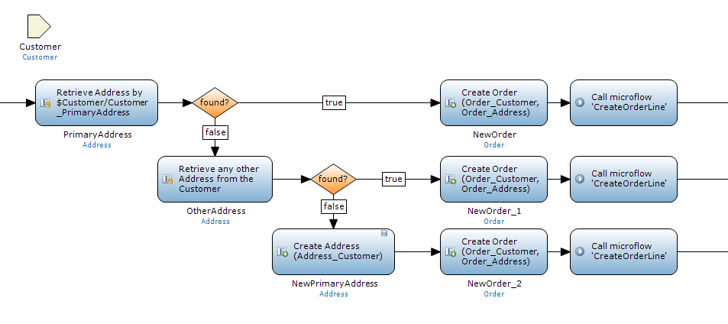
Low coding and No coding is about Visual Business Logic
Mendix “Microflow

Slide 22
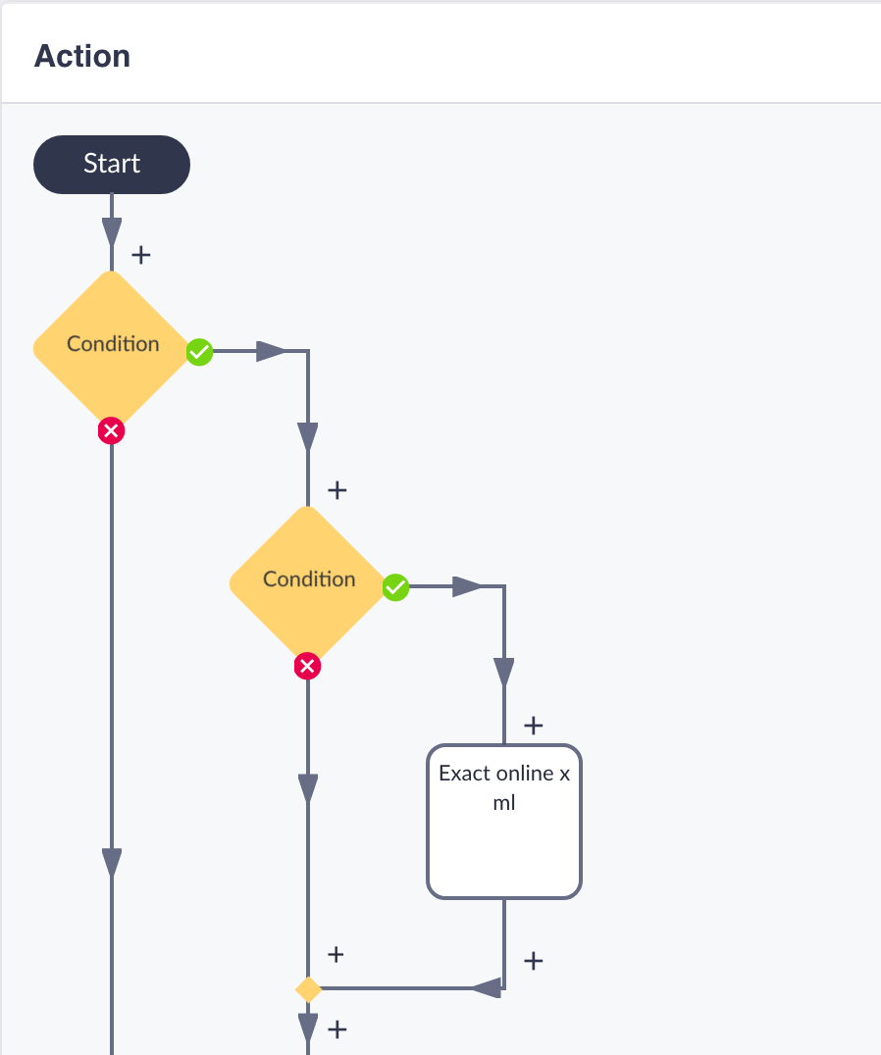
Low coding and No coding is about Visual Business Logic
Betty Blocks “Action”

Slide 23
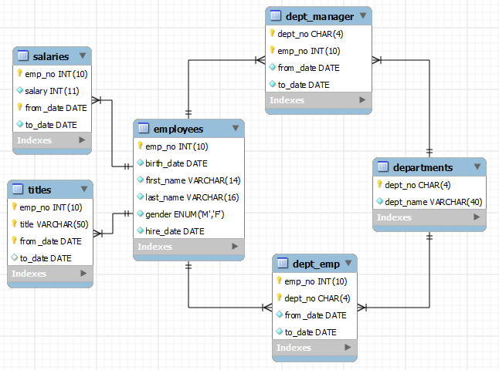
But there is a catch : Data modeling

Slide 24
So what is the new word in town ? / “Citizen Developer”

Slide 25
There is Hope : Sometimes it is not that complex
A simple marketing event app using visitor data and whishes
Presenting a new offering from available data
Creating a digital marketing support tool
Turning your own excel into a web based app for your fellow colleagues

Slide 26
Still: Sometimes you should leave it to a specialist
So called “System of Records” :
Word Processor, ERP, CRM
Mass produced and specialized products :
Stereo equipment
Scientifically defined processes.
A complex chemical power plant application
Software that doesn’t allow for improvisation on the fly: Air Traffic Control, Airplane

Slide 27
In many cases: Low Coding makes more sense
When you need to Experiment to find out the exact needs of your target users
When you have a Hunch or Hypothesis, but not yet a well analyzed plan
When Time-to-market is more essential then accurate business logic
When you are just collecting and recombining Data in new innovative ways
When you want to create an app that is not (yet) core to your business

Slide 28
Low/No-Coding is not ”The potion that solves every problem ”
Low/No-coding is Good:
When you need to interact with your user audience
to figure out needs and need to
adjust and adapt quickly with single and small changes
When a quick time to market is more important than operational cost
When you plan for multiple innovative solutions in a row and need to increase productivity of an existing team
Source : https://en.wikipedia.org/wiki/Haarlem_oil

Slide 29
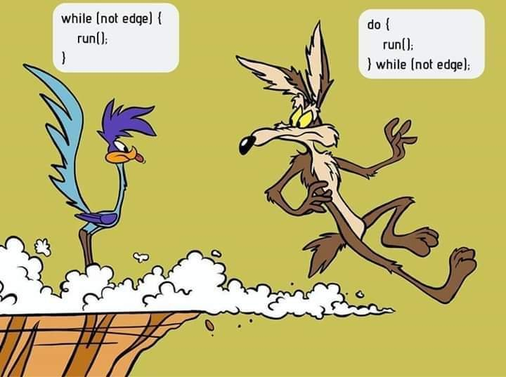
But even then: don’t start developing too soon
Source : www.reddit.com

Slide 30
Take one step backwards first
ZERO code

Slide 31
Concluding
Dit is een tekstje
Dit is ook een tekstje

Slide 32
Do it yourself / Many options for “Citizen Developers”

Slide 33
Do it yourself / Many options – Many limitations too
Flexible but Single user
Online but no business logic

Slide 34
Low & No Coding / Taking the programming out of software development
What Wordpress was to Front End
coding like HTML
Presenting Data Online
Is what No & Low coding is to Back End
software development creating Apps
Offering Business Logic Online too
“Drag and drop” ready building blocks in a visual manner
Creating your online solution without requiring expert IT know how

Slide 35
Up next
Zero Coding
A fast track into formulating your Ideas and making them tangible
Teysir Turunç – Resourcing Pros - Visual Engineering Studio
Low Coding
An interactive demo using one of the leading No-Code platform providers
Dirk– Betty Blocks expert at Nieuwland GIS Solutions

Slide 36
Edgar Kiwiet
edgar.kiwiet@innovation-kite.com
+31 6 2044 7064

