Slide 1
No Code & Design Thinking?
Visual Engineering Studio

Slide 2
Design Thinking / What is UX Design?
UX Design, short for User Experience Design is defined on Wikipedia as
“The process of enhancing user satisfaction by improving the usability, accessibility, and pleasure provided in the interaction between the user and the product.”
Source : https://en.wikipedia.org/wiki/User_experience_design

Slide 3
Design Thinking / What is UX Design?
“User Experience Design” is often used interchangeably with terms such as “User Interface Design” and “Usability”.
Usability and User Interface Design are important aspects of UX Design, they are subsets of it
UX design covers a vast array of other areas, too.

Slide 4
Design Thinking / What is UX Design?

Slide 5
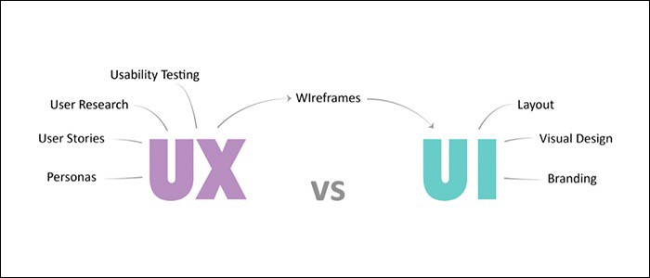
Design Thinking / What is UX Design?

Slide 6
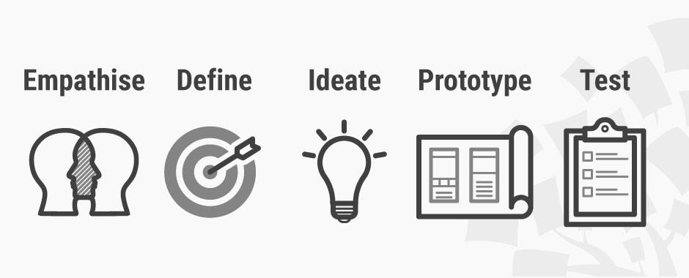
Design Thinking / Why, What and How?

Slide 7
Design Thinking / Why, What and How?
Design Thinking has a human-centered core. It encourages organizations to focus on the people they are creating for, which leads to better products, services, and internal processes.
Empathise – with your users
Define – your users’ needs, their problem, and your insights
Ideate – by challenging assumptions and creating ideas for innovative solutions
Prototype – to start creating solutions
Test – solutions

Slide 8
Design Thinking / Why, What and How?
We think we are all experts, right? But it is about avoiding this…

Slide 9
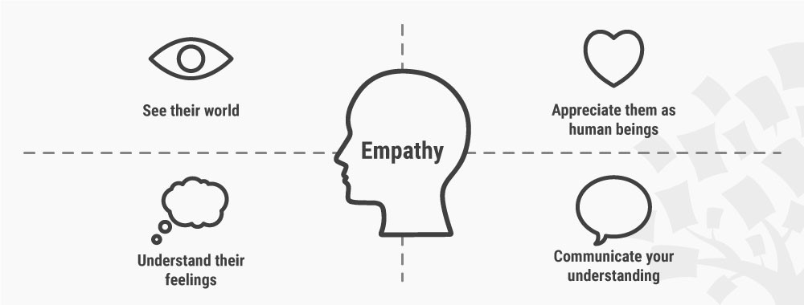
Design Thinking / Why, What and How?
Empathise – with your users
In order to…
Define – your users’ needs, their problem, and your insights
Source : https://www.interaction-design.org/literature/article/stage-1-in-the-design-thinking-process-empathise-with-your-users

Slide 10
Design Thinking / Outside of the box
Thinking outside of the box can provide an innovative solution to a sticky problem.
However, thinking outside of the box can be a real challenge as we naturally develop patterns of thinking that are modeled on the repetitive activities and commonly accessed knowledge we surround ourselves with.

Slide 11
Design Thinking / Outside of the box
We are all experts?.... What would you do to avoid further damage?
Thinking outside the fence…
Source : Author/Copyright holder: Daud. Copyright terms and licence: CC BY

Slide 12
Design Thinking / The meet app
So in short the app should collect data available through the registration form and then
Invite via e-mail the people who registered to join the DW networking app
Source : https://www.interaction-design.org/literature/article/stage-1-in-the-design-thinking-process-empathise-with-your-users

Slide 13
Design Thinking / The meet app
Then allow those people to fill in relevant information for post-event networking:
sector in which one is active
expertise
interests
profile of who you’d like to meet (based on previous categories)
On the day of the DW evening the app presents you who matches your networking wishes
If you accept the matches, the app puts the matches into a Whatsapp group so they can chat and agree on how to meet.

Slide 14
Design Thinking / The meet app
Source : https://www.interaction-design.org/literature/article/stage-1-in-the-design-thinking-process-empathise-with-your-users

Slide 15
Design Thinking / Wireframes
A wireframe is a schematic, a blueprint, useful to help you and your programmers and designers think and communicate about the structure of the software or website you're building.
It looks so natural, I could have thought of that too!?
Correct, design thinking is for everybody as long as you can use the principals and think out of the box.
Low code tools could be very useful to create your first prototypes.

Slide 16
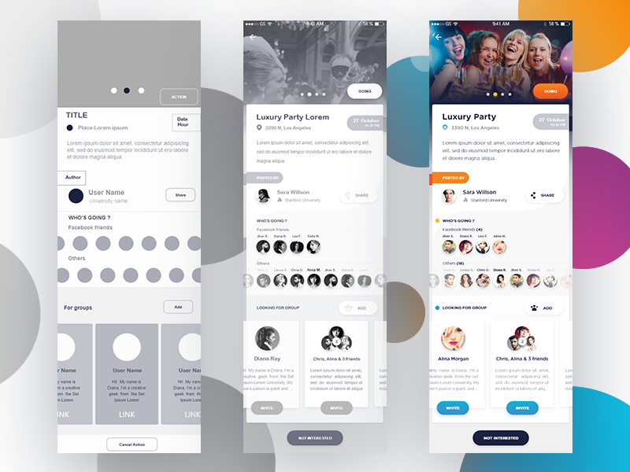
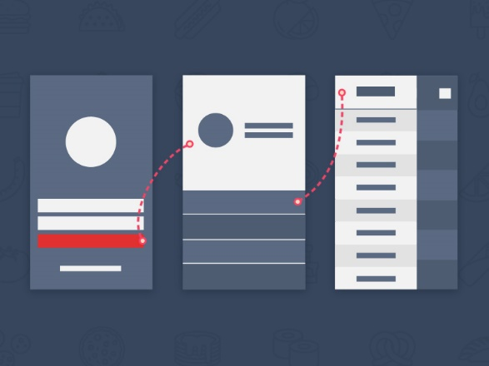
Design Thinking / Wireframes
Source https://www.invisionapp.com/inside-design/wireframe-examples/

Slide 17
Design Thinking / Low Code UI Builders
Betty Blocks - UI – builder
The UI Builder is a WYSIWYG editor. The name says it all. You can create a user interface by drag and dropping elements on the page. There are 5 categories you can choose elements from when using the editor :
Content ; Form ; Layout ; Lists ; Navbar

Slide 18
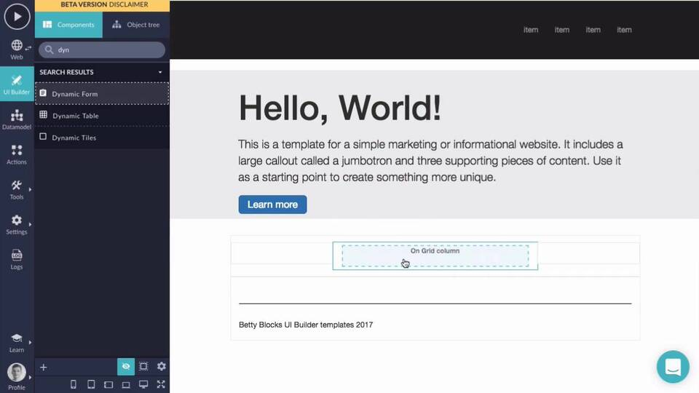
Design Thinking / Low Code UI Builders
Betty Blocks UI builder demo

Slide 19
Design Thinking / Low Code UI Builders
Mendix provides Atlas UI for this purpose Atlas UI is a layered, componentized framework designed to support UI construction through a combination of assembly, customization and standardization.
A fully WYSIWYG (what you see is what you get) cloud-based visual development tool that goes hand in hand with the Atlas UI framework to quickly and easily create responsive page designs and app flows.
Not just wireframes or prototypes—real apps.
https://atlas.mendix.com/

Slide 20
Design Thinking / Low Code UI Builders
Mendix Atlas UI demo

Slide 21
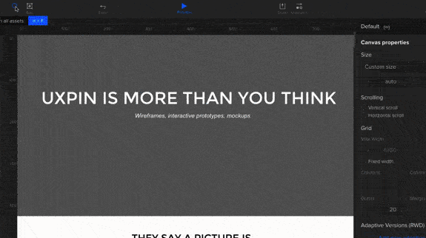
Design Thinking / Uxpin Zero Code
I’m using Uxpin, a WYSIWYG design tool (Zero code)
It allows to design, collaborate, and present wireframes, mockups, and prototypes.

Slide 22
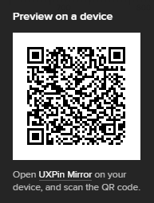
Design Thinking / Conpetto Meet app demo
Start Uxpin Mirror
Scan the QR code to start the demo on your device

Slide 23
Design Thinking / Betty Blocks Demo
Betty Blocks Demo

Slide 24
Thank You!

